Slide 1


Titolo presentazione sottotitolo
R&DD project SE2– 2023/2024
Milano, XX mese 20XX
Group: Tommaso Capacci, Gabriele Ginestroni

Slide 2
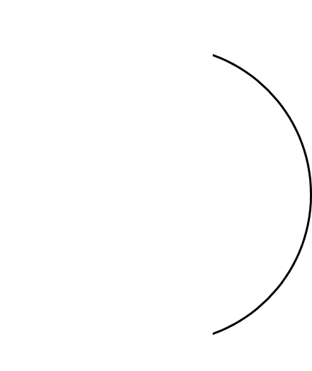

Agenda
1
RASD
2
DD
3
Conclusions

Slide 3
RASD

Slide 4
System boundaries and Phenomena
World
Machine
Educator creates tournament/battle
Student forks repo
Student creates/joins a team
Student setups GitHub Actions
System checks deadline
Team commits a new solution
System creates GitHub repo
Students communicate with each other
System evaluates code quality
System pulls submission code
System evaluates submission (functional and timeliness)
System computes and updates score/rank
Educator challenges students

Slide 5

Goals
Allow students to participate to collaborative programming challenges
Allow educators to create programming challenges
Allow the system to automatically evaluate students' submissions
Allow educators to manually evaluate students' submissions
Allow students to track their performance

Slide 6

Assumptions
Supported programming languages are limited to popular options like Java, Python and C++
Educators upload correct test cases and well-structured Code Kata projects
Students will fork the Code Kata GitHub repository once ready
Students know how to setup a GitHub Actions workflow
Only one student per group will perform the steps needed to set-up the team's repository and the GitHub Actions workflow
Static analysis tools are able to quantify the specified code quality aspects

Slide 7
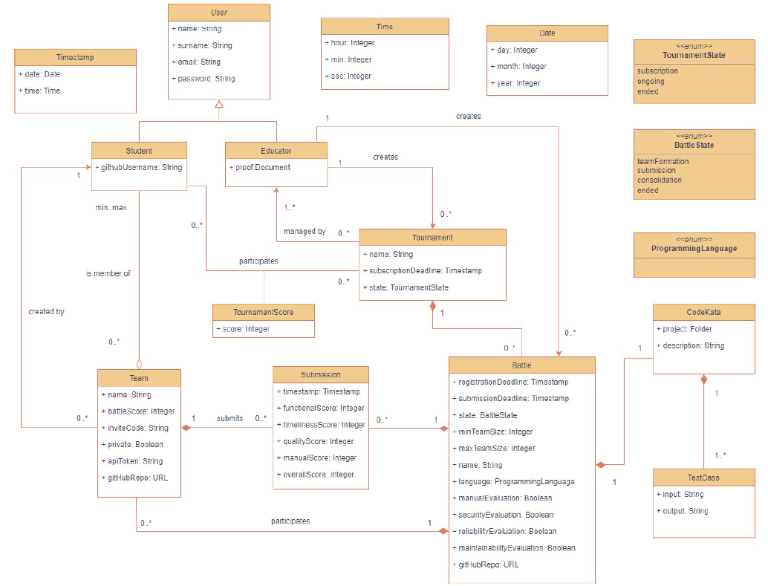
Alloy
Motivations:
Formalization of the ER diagram and other constraints not represented by it
Generation of worlds to verify goals satisfaction
Unambiguous formalization of constraints expressed by system’s requirements
How:
Static analysis focusing on tournament/battle states, timestamps and scores

Slide 8
DD

Slide 9
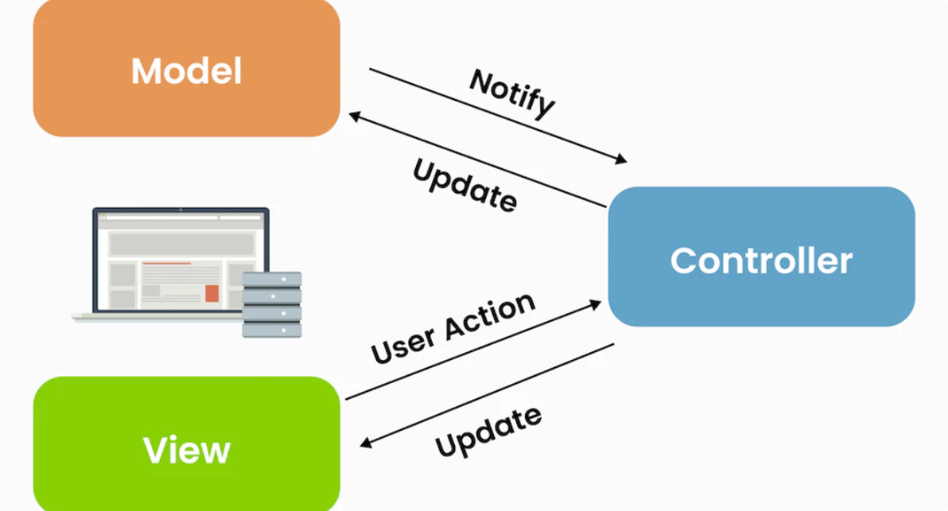

Architectural Style and Patterns
Microservices
Routing patterns: Service Registry
Security patterns: OAuth2 protocol
Communication patterns: RESTful hybrid communication (synchronous and asynchronous)
API Gateway: facade and reverse proxy
Model-View-Controller

Slide 10
Components and Interfaces
Services:
AuthService
TournamentService
EventService
GitHubIntegrationService
EvaluationService
NotificationService
Queues:
NotificationQueue
SubmissionQueue
EventQueue
Databases:
TournamentDB
UserDB
Interfaces offered by the system:
APIGatewayI
CommitI
Interfaces used by the system:
SSO API
Github API
Static Analysis API
Email API
TournamentDBMS API
UserDBMS API

Slide 11
Other design choices
Database technologies:
Document-based DB
Relational DB
Scalability:
Microservices easily replicated through Docker
Thread-per-request model
Availability:
Replication:
Web server & API Gateway with Load Balancing
Service Registry with Master-Slave schema and service-side caching

Slide 12
Implementation, Integration and Testing
Bottom-up approach:
Stubs for testing queues
Additional stub to solve cyclic dependency between TournamentService and EventService
Regression testing at multiple levels:
Unit testing
Integration testing
System testing (e2e with Selenium)
User acceptance testing

Slide 13

Firma convenzione Politecnico di Milano e Veneranda Fabbrica del Duomo di Milano
Thanks for your attention
Aula Magna – Rettorato
Mercoledì 27 maggio 2015

